Slide 1




project 3
Superstore Data Analysis
Source : Kaggle
Prepared by :
Catherine, Gita, Kabir, Wisdom
8 January 2025

Slide 2


overview of superstore data
The dataset contains information about a superstore’s operation.
The context of the data based on :
Order Details (order id, order date, ship date, ship mode)
Customer Information (customer id, customer name, segment)
Geographic Details (country, city, state, postal code, region)
Product information (product id, category, sub-category, product name)
Metrics (sales, quantity, discount, profit)
Data Size : 21 columns, 9994 rows
Link : https://www.kaggle.com/datasets/vivek468/superstore-dataset-final/data

Slide 3

ANalysis
questions, method

Slide 4

analysis questions
Catherine
Gita
Kabir
Wisdom
Correlation between profitability and popularity between each category across the fiscal years.
Impact of discounts on sales, order frequency, and profit.
Individuals who spent the most each year.
Monthly/seasonal trends in sales and profitability.
Year-over-year performance trends based on sales and order quantity by Order ID unique.
States with the highest profitability.
Cities or states with the highest profit and their top-performing items.
Average order cost and profit by region.
Most popular and profitable regions.
Most profitable customer segments (Home Office, Corporate, Consumer).
Contribution of segments to regional sales and profit.

Slide 5


Annual Performance Trends
Geographical Sales and Profit Overview
Category and Shipment Insights
Discount Analysis:
Impact on Revenue and Profitability
Category Profitability Analysis

Slide 6
Analysis Method
Research for data
Tools and libraries for analysis :
Brainstorming Session
Jupyter Notebook
Pandas
Pathlib
Matplotlib
Plotly
Seaborn
Numpy
Folium
Squarify
HTML
Python
Javascript
SQL
Data Cleaning

Slide 7

Annual Performance Trends

Slide 8
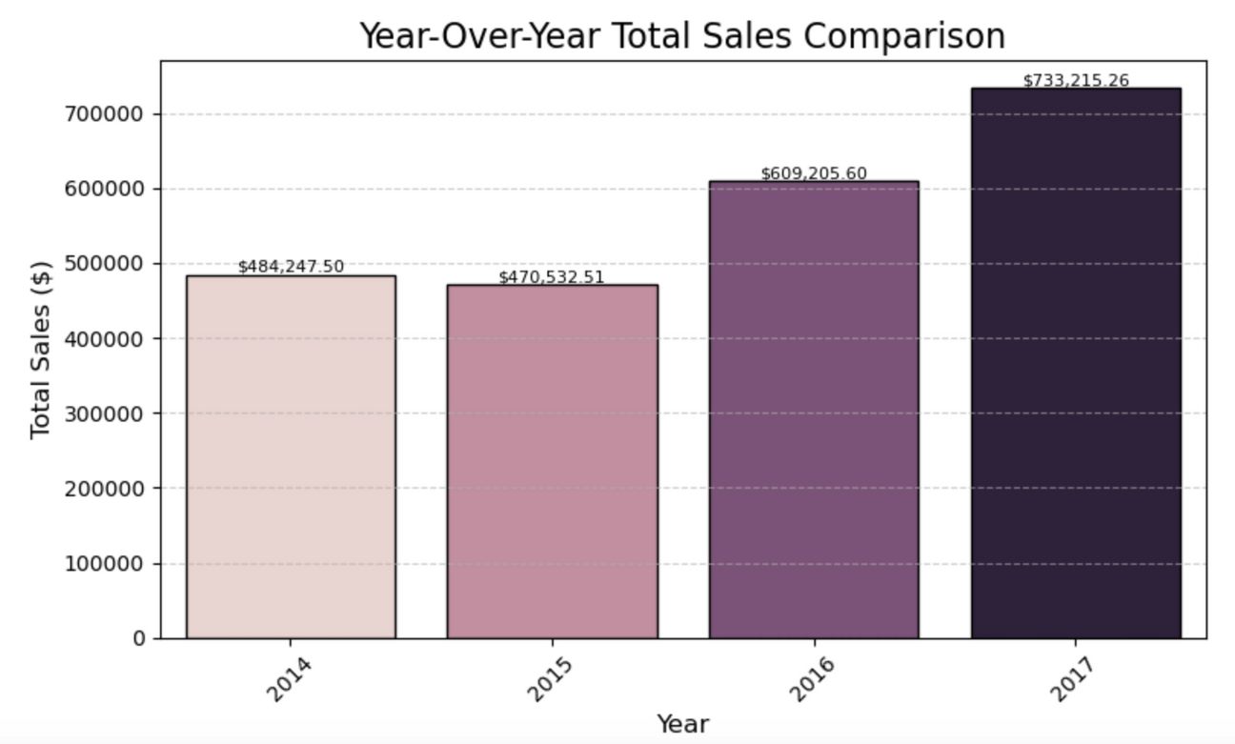
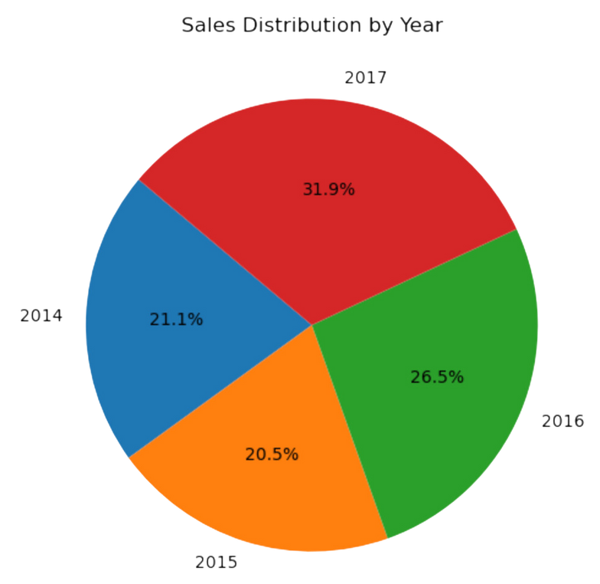
year-over-year performance
by sales :

Slide 9
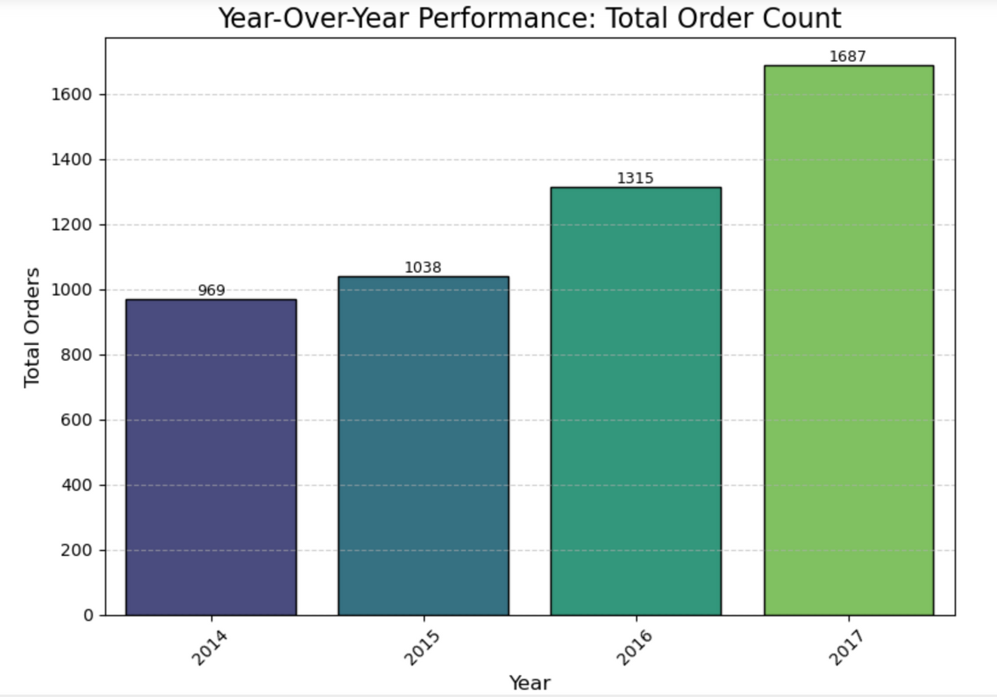
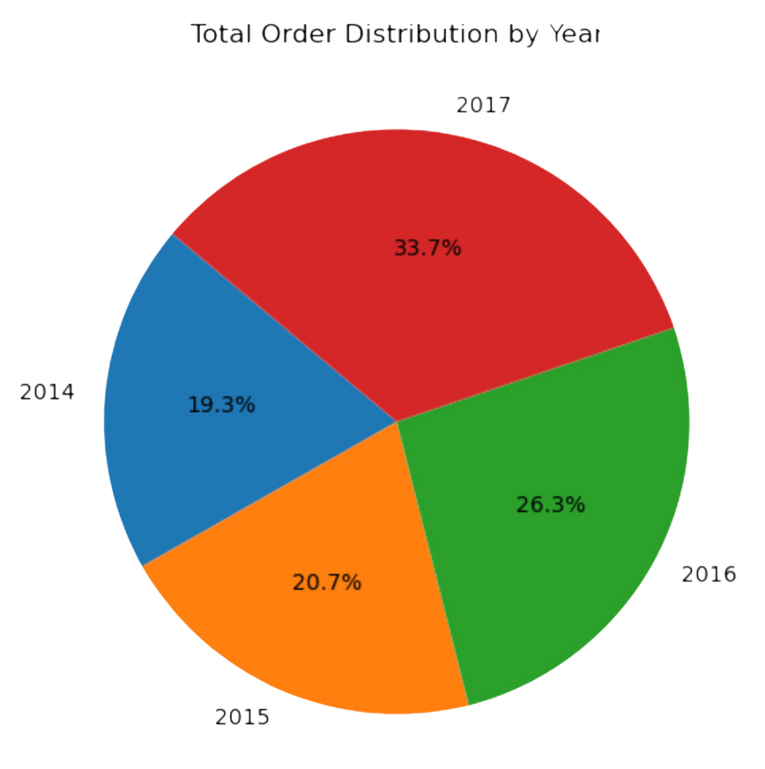
year-over-year performance
by order ID count :

Slide 10
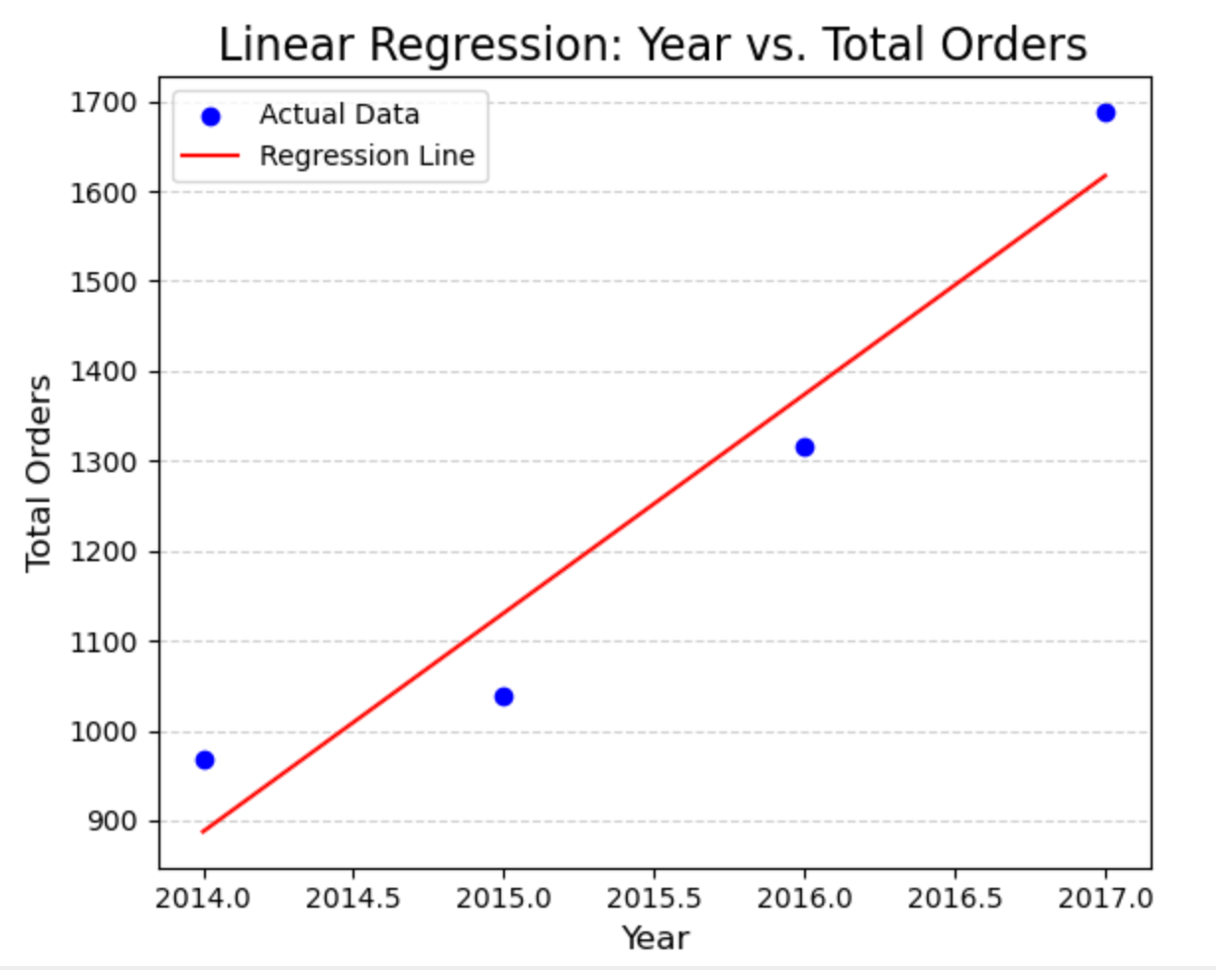
year-over-year performance

Slide 11
INSIGHTS
The business experienced steady growth in total sales, with 2017 being the most significant year for revenue.
The growth in order count aligns with the increase in sales, highlighting improved customer acquisition (more new customers) and retention (repeat purchases).
The trendline confirms the year-over-year steady growth in orders over time.

Slide 12
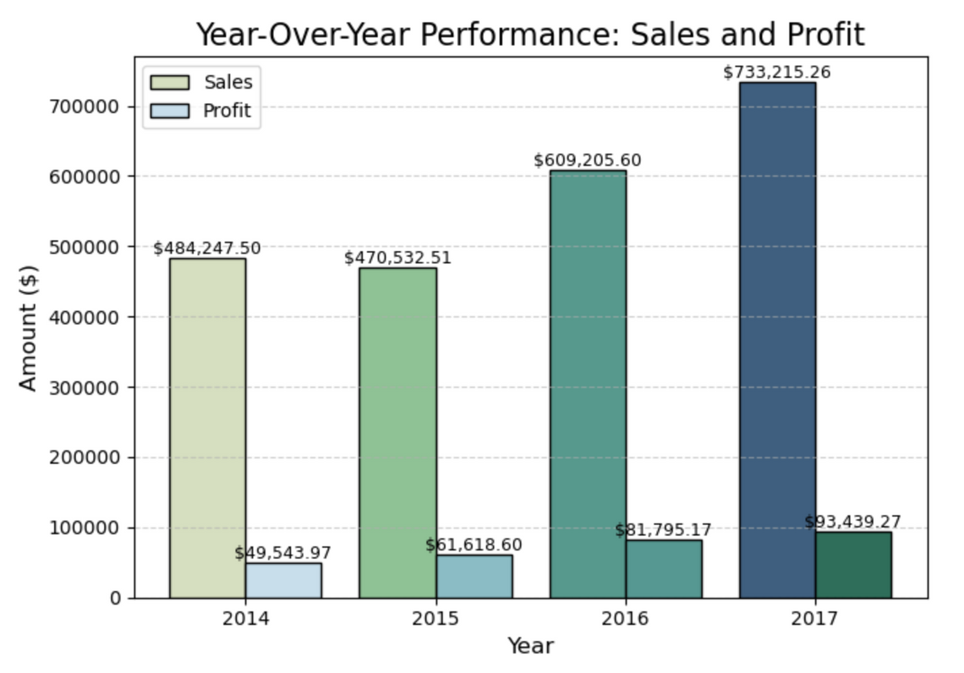
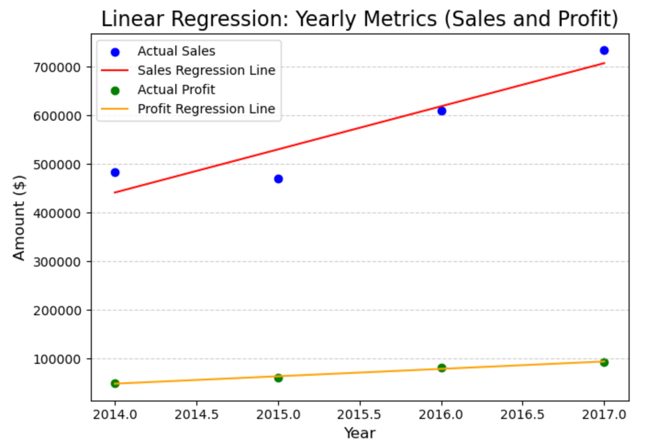
year-over-year performance

Slide 13
INSIGHTS
While sales grew significantly each year, profit margins show a steadier increase, suggesting efficient cost management or higher profitability strategies in recent years.
Scatter Plot with Linear Regression: Sales and Profit
Sales and profit show a positive linear trend over the years, confirming sustained growth.
Profit, however, has a less steep regression line compared to sales, emphasizing the need for further profitability enhancements.

Slide 14
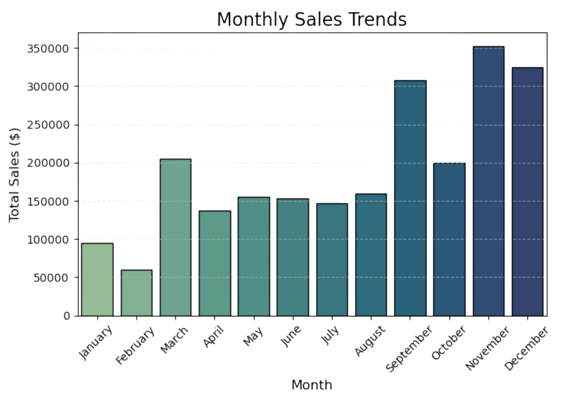
monthly sales trend

Slide 15
INSIGHTS
The business experiences seasonal variations in sales, with the latter half of the year being particularly strong. September, November, and December show the highest sales, exceeding $300,000 each, indicating potential peak seasons for the business.

Slide 16
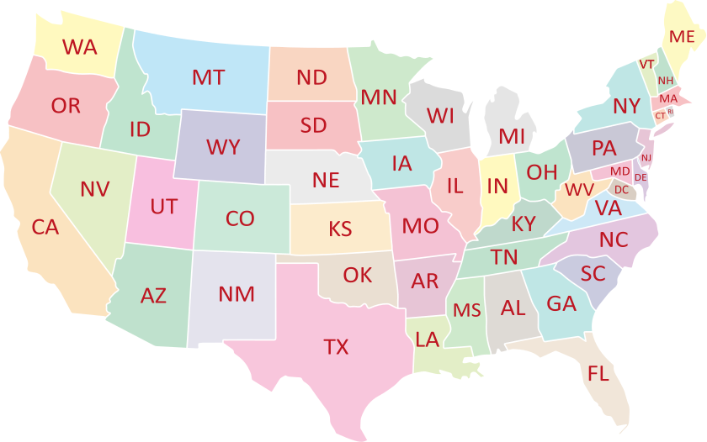
Geographical Sales and Profit Overview

Slide 17
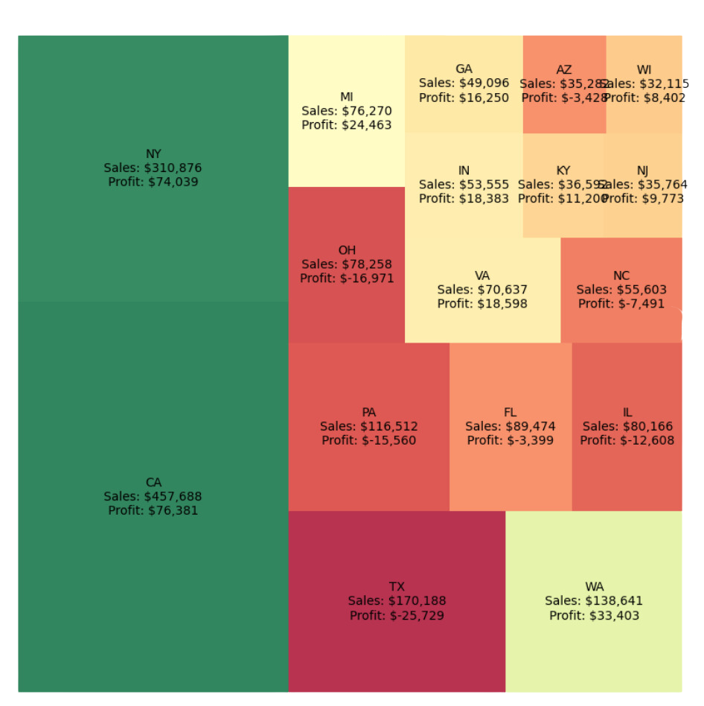
Analysis of sales by state
Top 17 States :

Slide 18
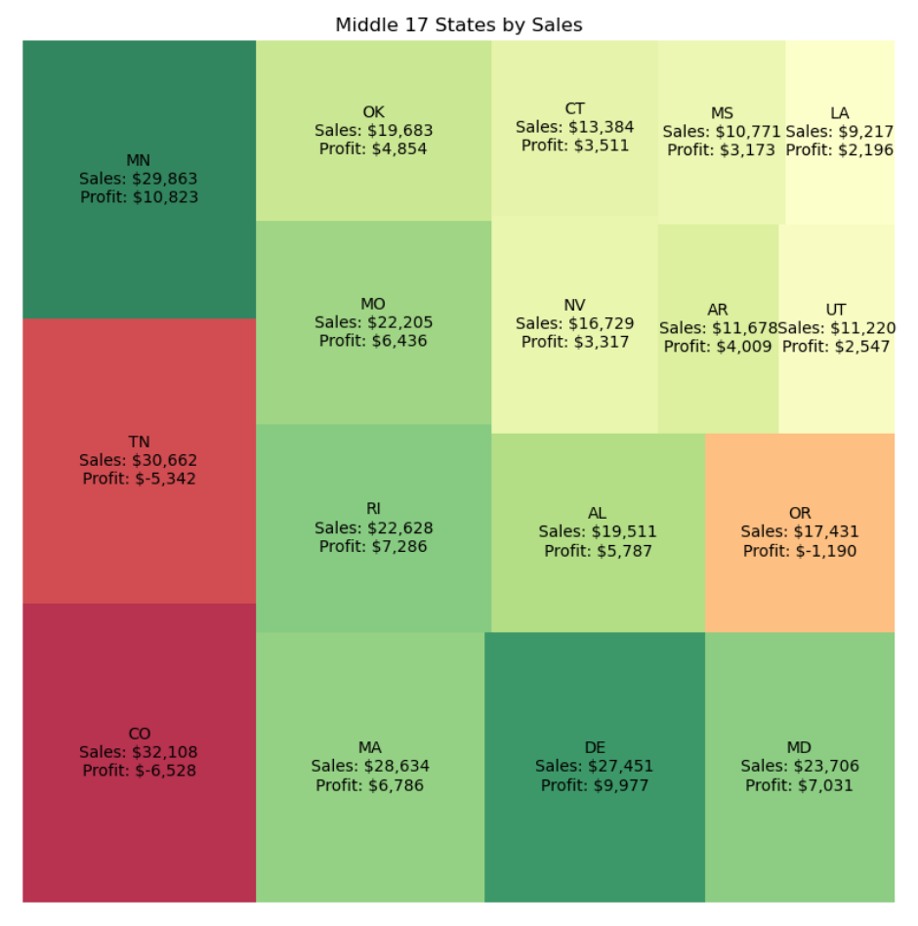
Analysis of sales by state
Middle 17 States :

Slide 19
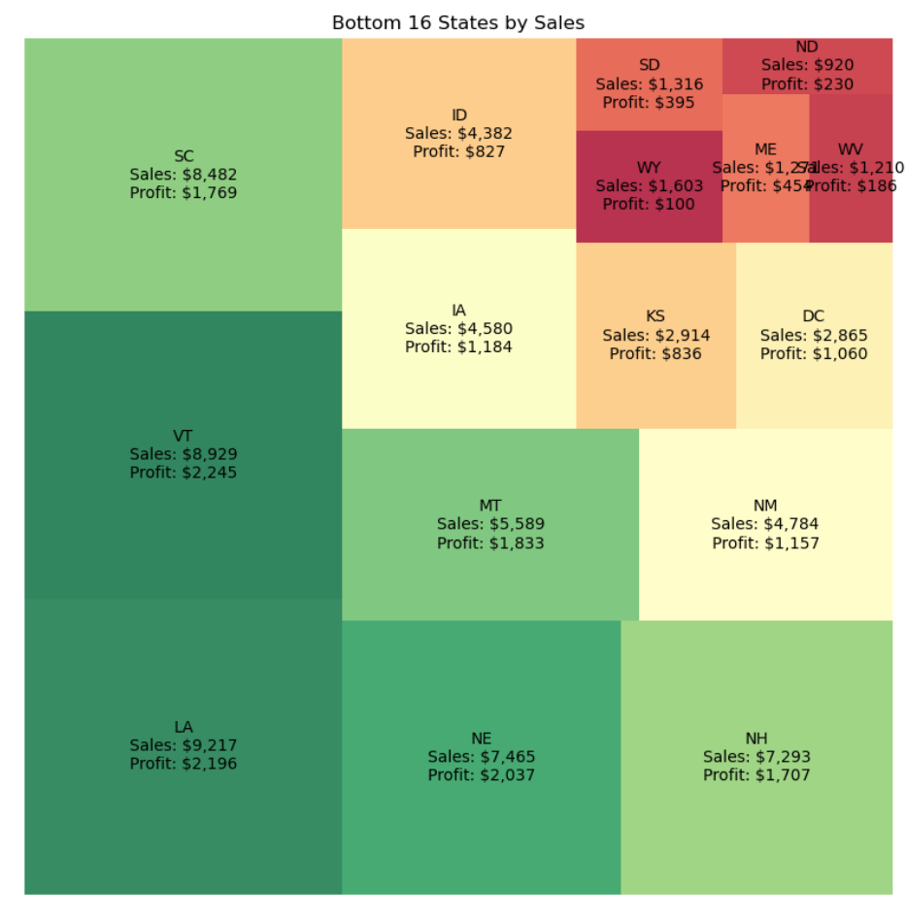
Analysis of sales by state
Bottom 16 States :

Slide 20
Insights:
California and New York both had very high sales and profit, making them the most profitable states by far and highlighting their operational efficiency.
Texas, despite being a high sales state, operates at a significant loss (shown by the negative profit) which indicates their may be high costs and inefficiencies.
We also see many underperforming states, which have negative profits despite having moderate to high sales such as Ohio, Pennsylvania and North Carolina. This again suggests high costs and inefficiencies and are areas where the company should focus on optimizing costs.

Slide 21
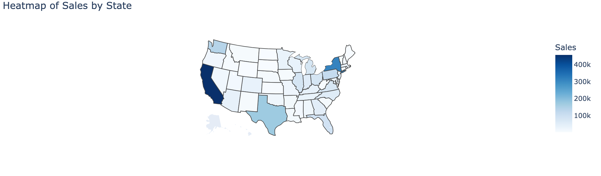
Heatmap of sales by state

Slide 22
Insights
The heatmap further suggests that majority of the sales come from only a few states, and hence the priority of the company should be to expand marketing efforts in underperforming regions to boost sales and profit, and consider why these regions are incurring losses.

Slide 23
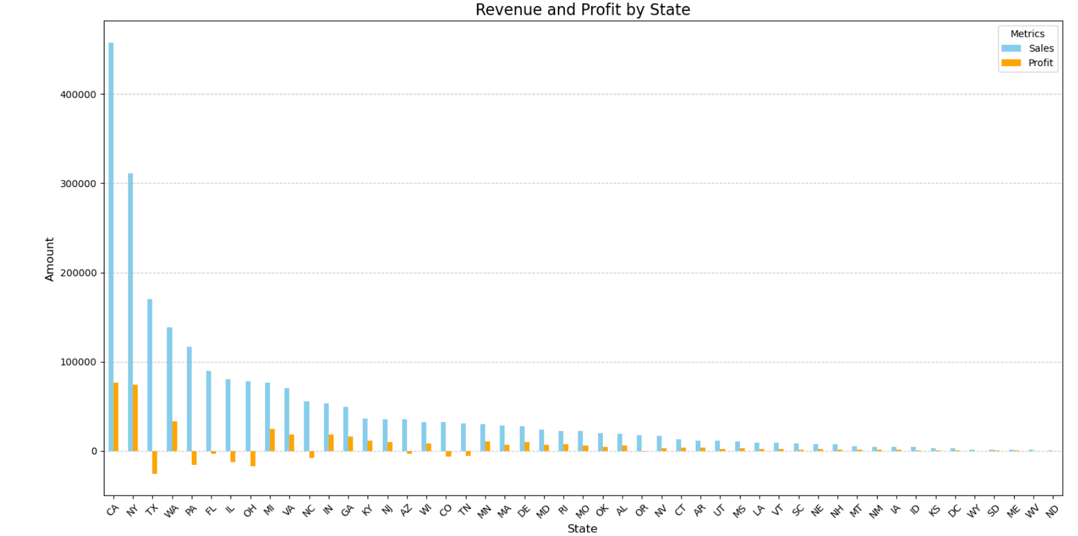
revenue and profit by state

Slide 24
Insights
Sales and profit are concentrated in just a few states such as California, New York, and Washington.
Similarly we see many states with high sales suffering from heavy losses.
We recommend investigating and identifying the reasons that high sales states incur losses, and identifying cost-saving oppotunities or making price adjustments so that the company can optimize their profits in areas where sales are high

Slide 25
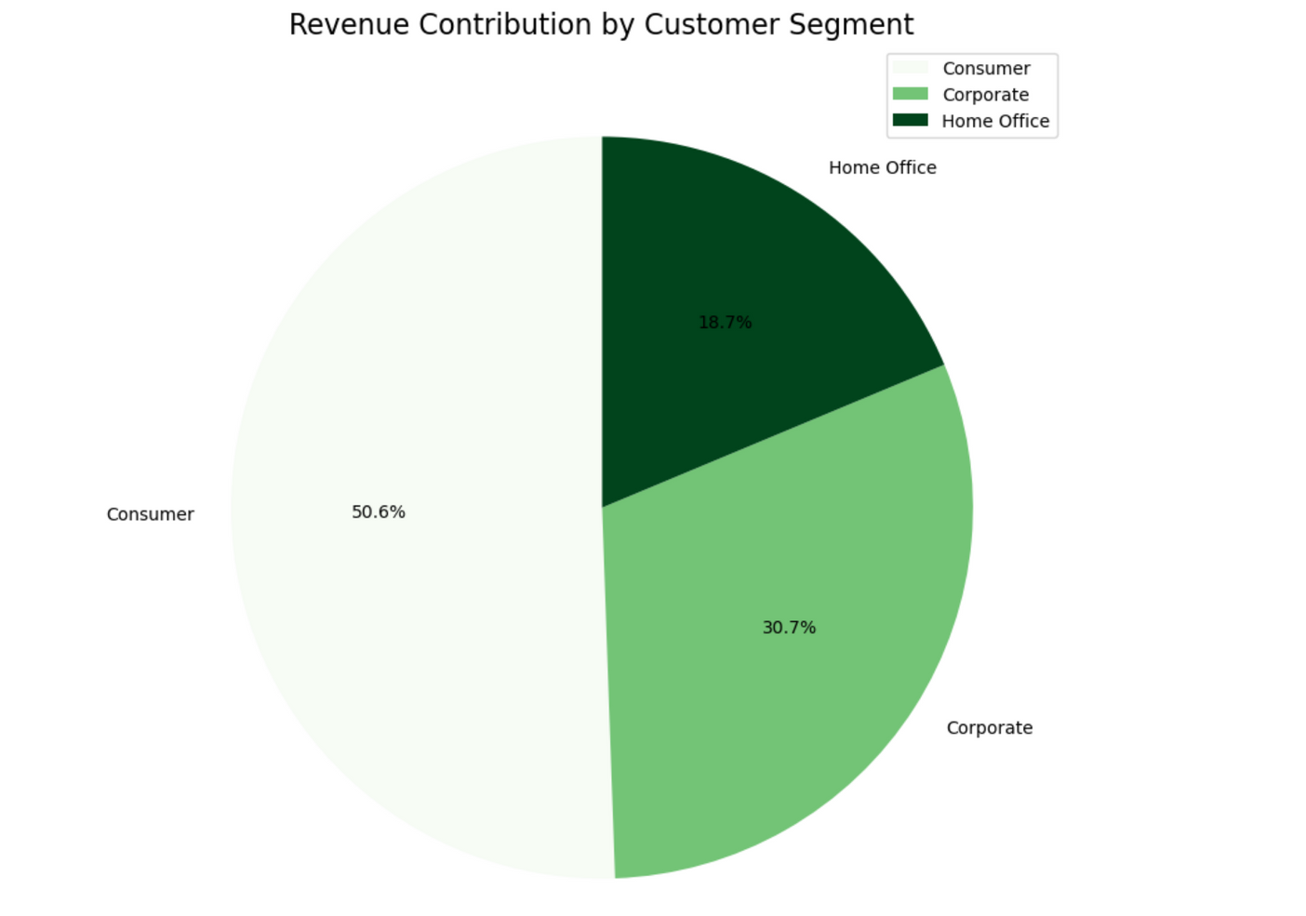
revenue contribution by customer segment

Slide 26
Insights
The Home office has the smallest segment of contributon which suggests it has incentives for targeted marketing to result in higher sales in that segment.

Slide 27
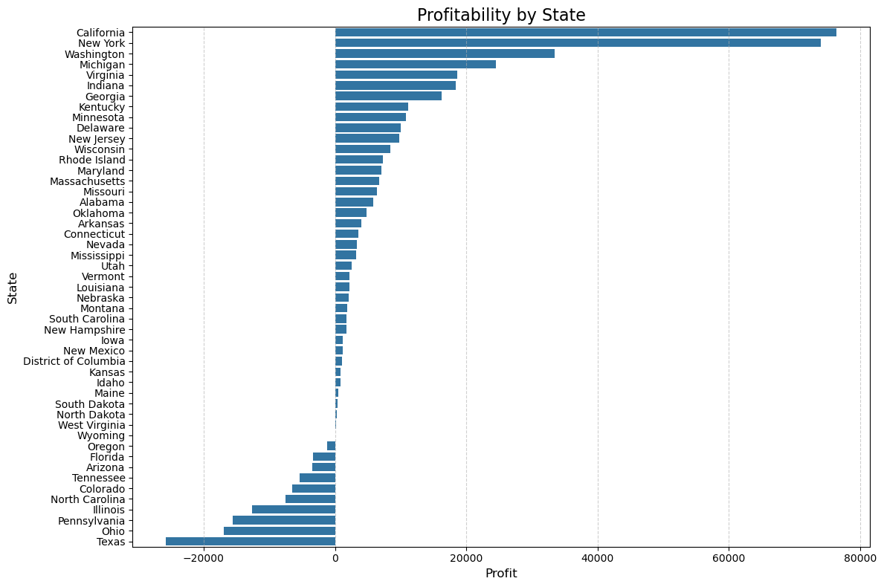
profitability by state

Slide 28
INSIGHTS
States like Texas, Ohio, Illinois that show negative profitability could be as a result of ineffective pricing or discounts, low demand or high operational cost.
For top performing states, marketing and sales effort should be consistent to continue to drive growth.

Slide 29


Category and Shipment Insights

Slide 30
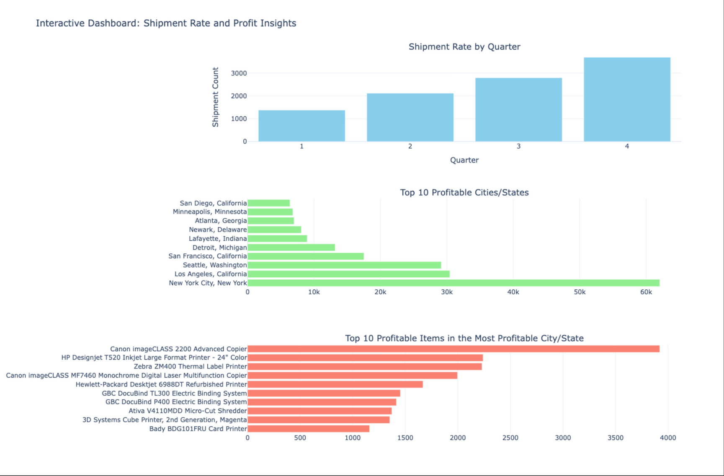
Analysis of Shipment Rate by Quarter

Slide 31
INSIGHTS
Q4 has the highest shipment rate, indicating a peak in customer demand, possibly driven by holiday seasons like Thanksgiving, Black Friday, Cyber Monday and Christmas sales.
Q1 might need promotional efforts to boost sales.
Profitable Cities/States
New York shows the most promise for the company.
California and Washington show potentials of growth, while other cities need targeted strategies to improve profitability
Profitable items in the most profitable cities
Office equipment like copiers and printers show the most profitability, indicating greater demand for this product category. This could be influenced by the presence of more companies and establishments in these cities. There is a need to promote other product categories to boost sales and profitability.

Slide 32
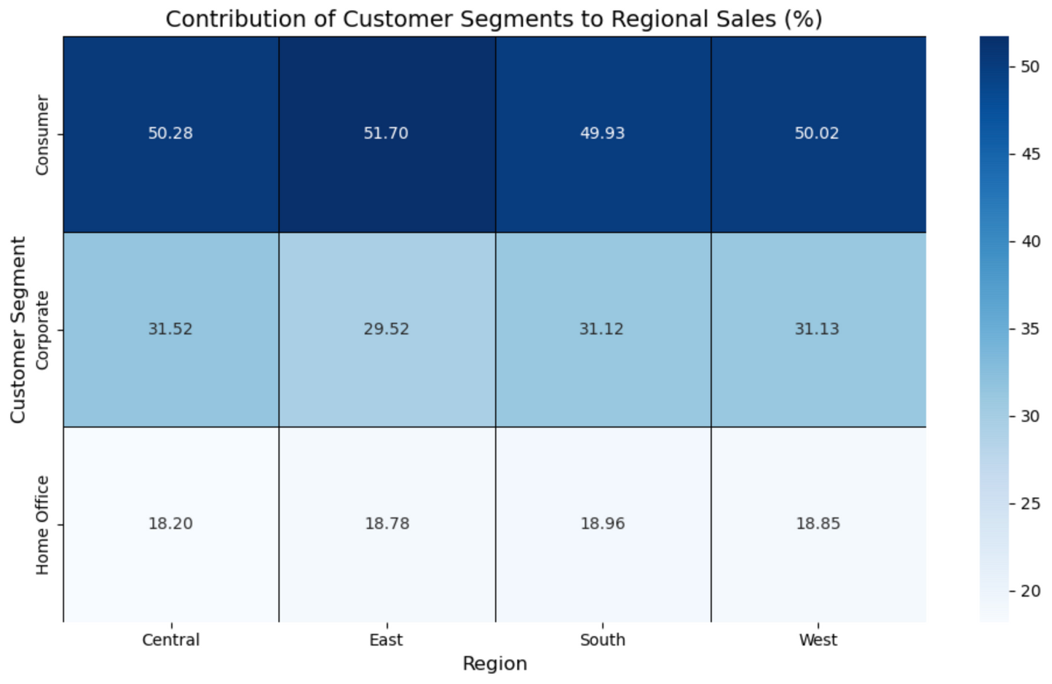
Heatmap Showing the Contribution of Customer Segments to Regional Sales

Slide 33
INSIGHTS
Sales
The consumer segment dominates sales contribution across all regions, contributing approximately 50% in every region. It is the primary driver of sales across all regions, indicating its importance as a key customer segment. The differences between the consumer segment, the corporate segment and home office segment highlights a potential opportunity to target the corporate and home office segments more effectively to increase sales.
We also see a uniform customer behavior pattern across regions.

Slide 34
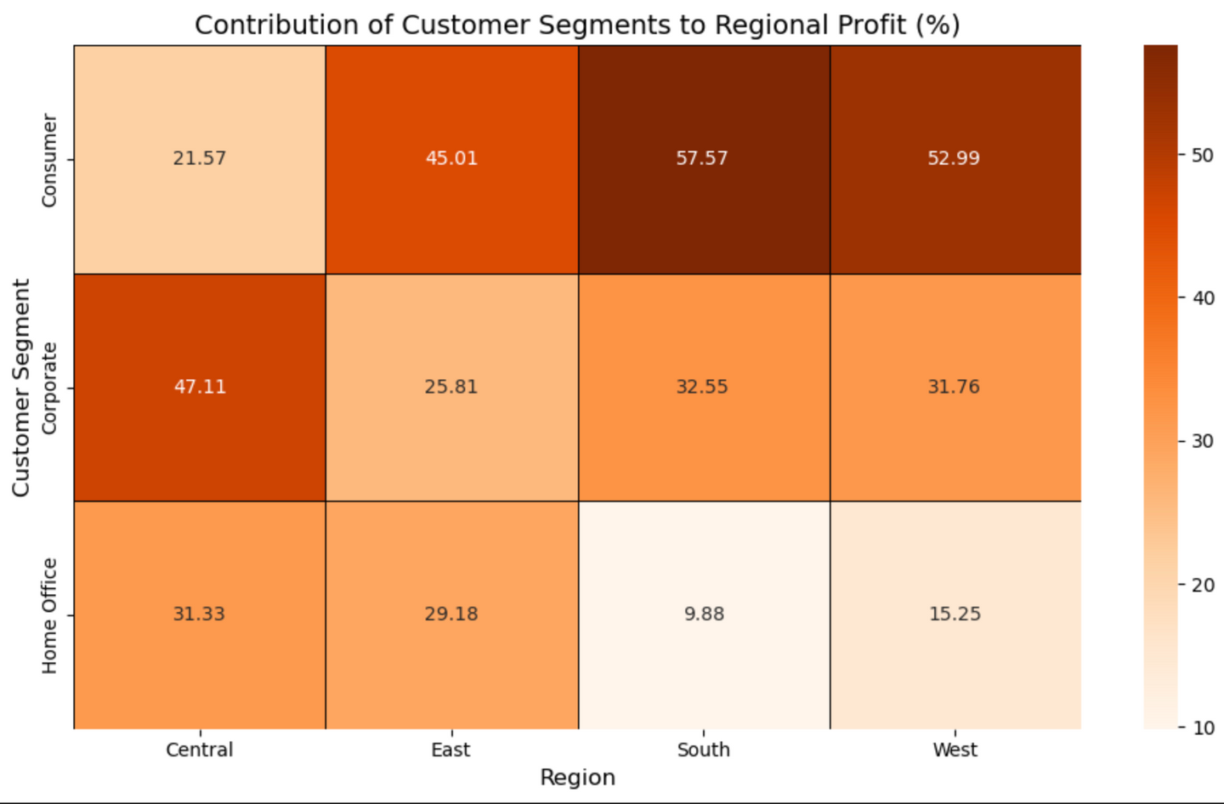
Heatmap Showing the Contribution of Customer Segments to Regional Profit

Slide 35
INSIGHTS
Profit
The Consumer segment shows the most profit in the South and West regions, suggesting these areas heavily rely on individual consumers for profitability.
The Corporate segment has a stronger performance in the central region, while the home office performs poorly in the south. This indicates an opportunity to boost profit in specific regions with targeted strategies.

Slide 36
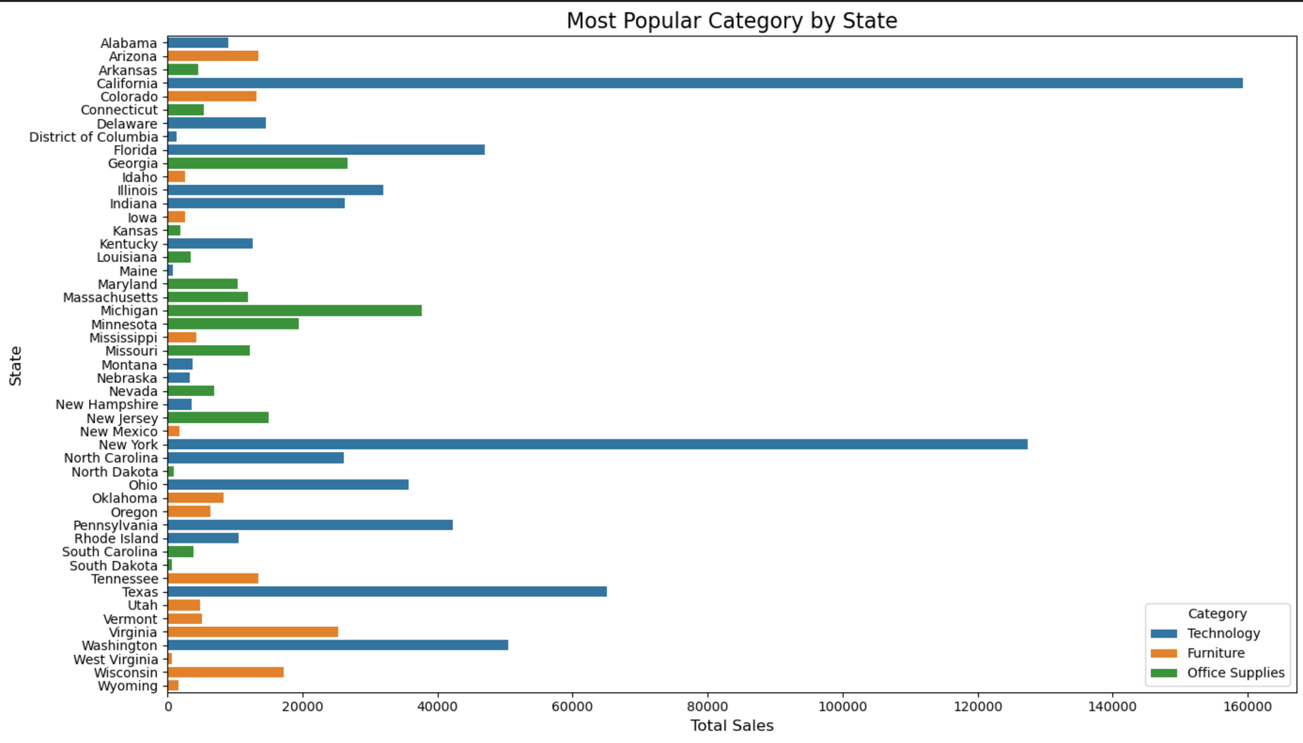
most popular category by state

Slide 37
INSIGHTS
Technology is the most popular category in most states. It shows high sales in California, New York and Texas. This could be because of the large population in these states and the presence of Tech industries due to urbanization.
There is a need to prioritize the sales of technology products in these states.

Slide 38


Discount Analysis:
Impact on Revenue and Profitability

Slide 39
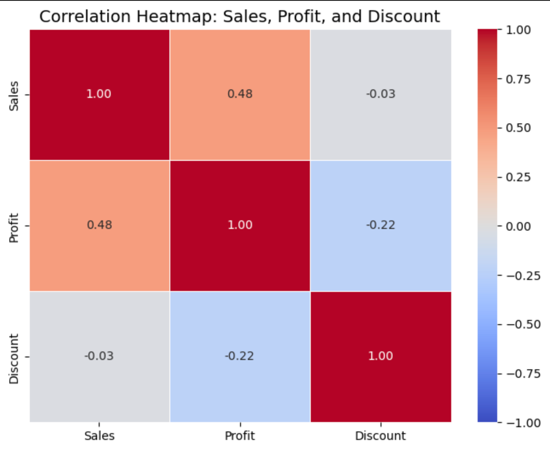
Correlation Between Sales, Profit and Discount

Slide 40
INSIGHTS
There is a moderate positive correlation between sales and profit. As sales increase, profits also tend to increase.
There is a weak correlation between profit and discount. As discounts increase, profits decrease slightly.
Discount should not be used as a method of boosting sales.

Slide 41
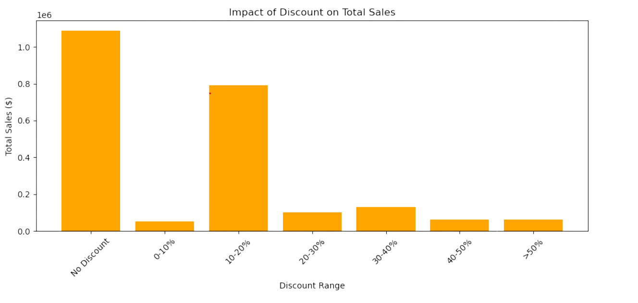
Impact of discount on total sales

Slide 42
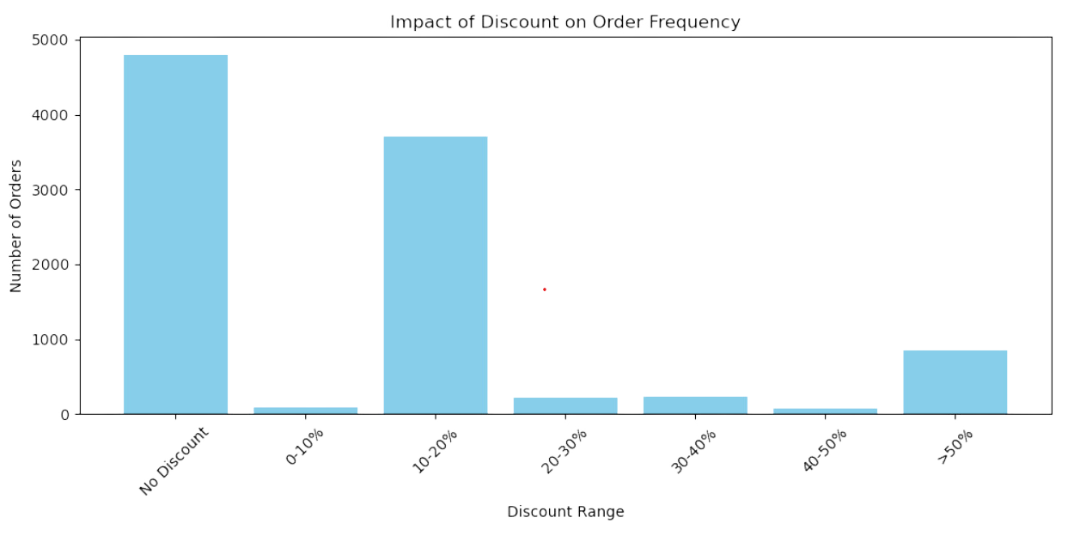
Impact of discount on order frequency

Slide 43
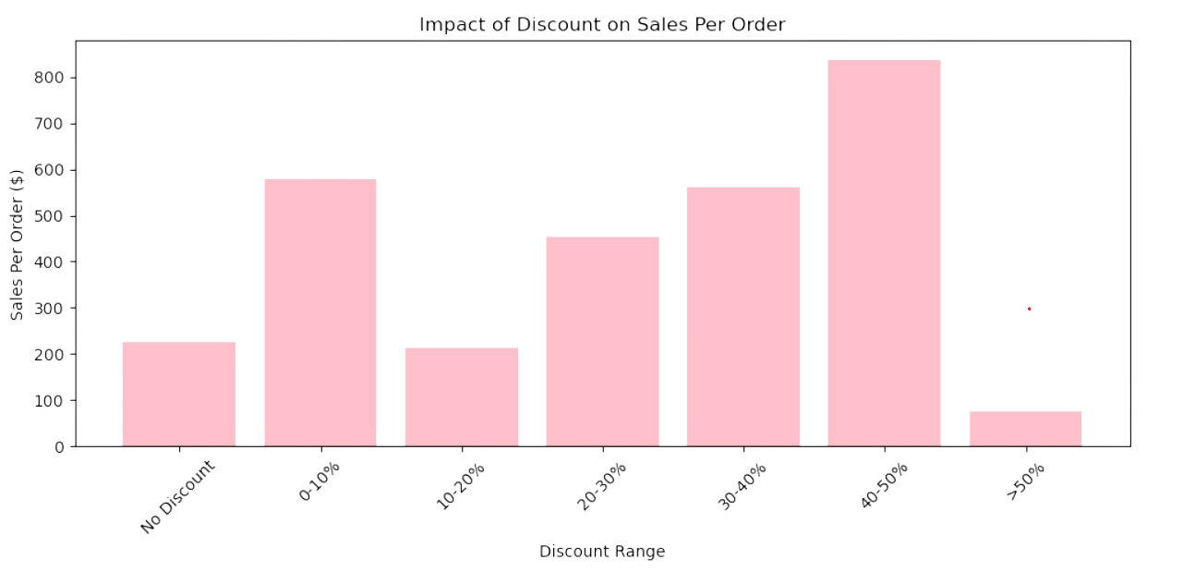
Impact of discount on sales per order

Slide 44
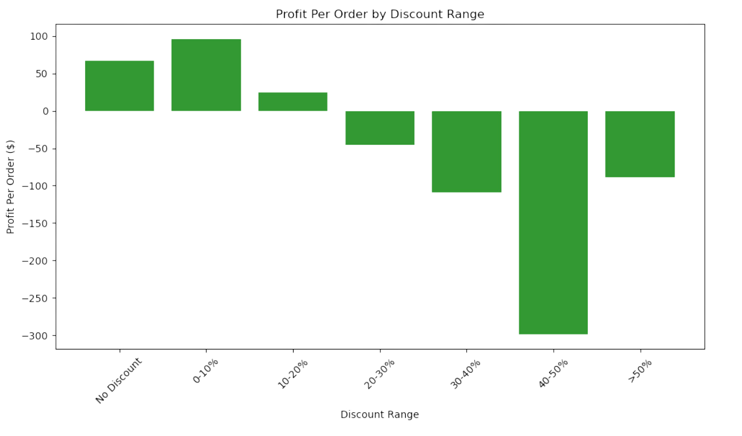
profit per order by discount range

Slide 45
INSIGHTS
Discount Analysis
The highest frequency of orders are items with no discount followed by items discounted within the 10-20% range then items with a greater than 50% discount.
After normalizing the data, it is still indicated that the item with no discount still had the highest dollar amount in sales by far followed by the items discounted in the 10-20% range.
The items with the highest profit per order belong to the 0-10% discount range while items discounted at 40-50% have the lowest profit per order.

Slide 46

Category Profitability Analysis

Slide 47
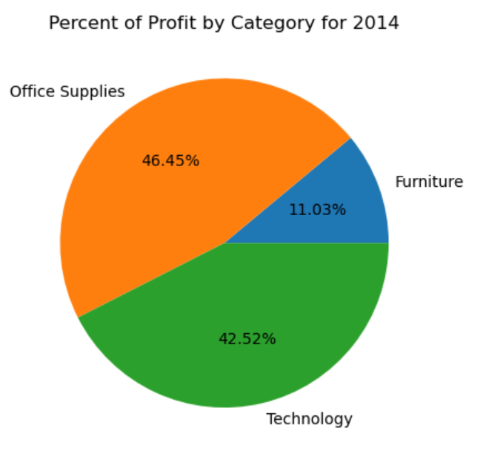
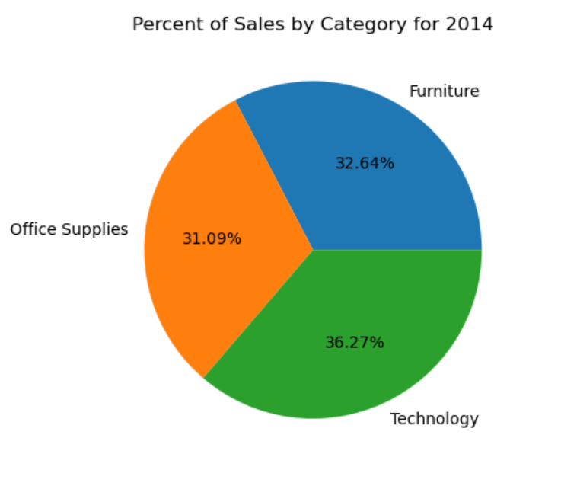
Comparing Sales Versus Profit in Categories
Fiscal Year of 2014

Slide 48
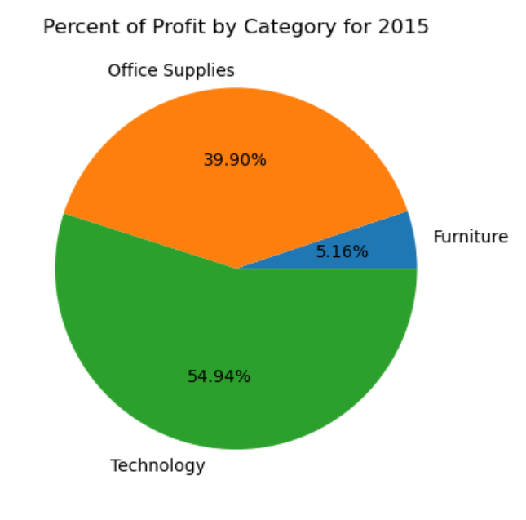
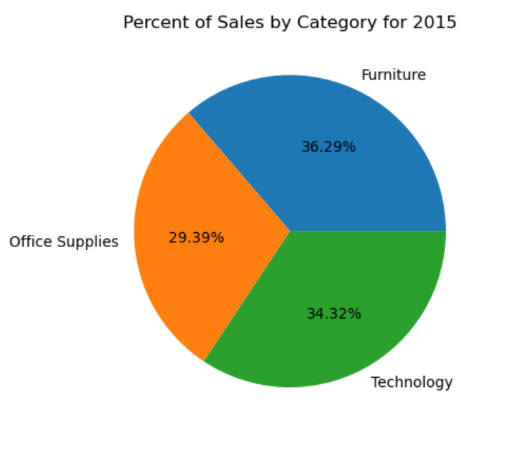
Comparing Sales Versus Profit in Categories
Fiscal Year of 2015

Slide 49
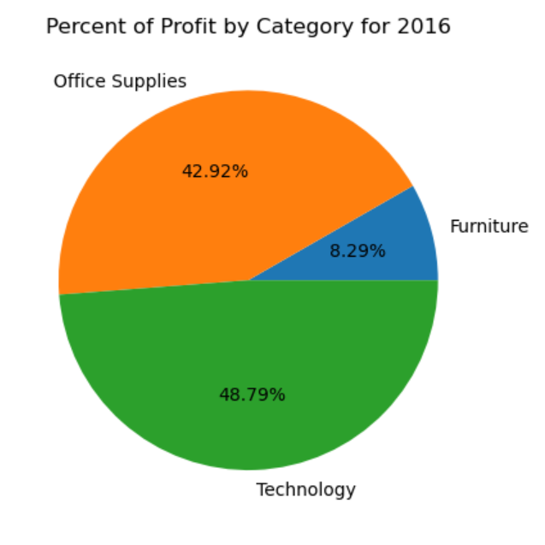
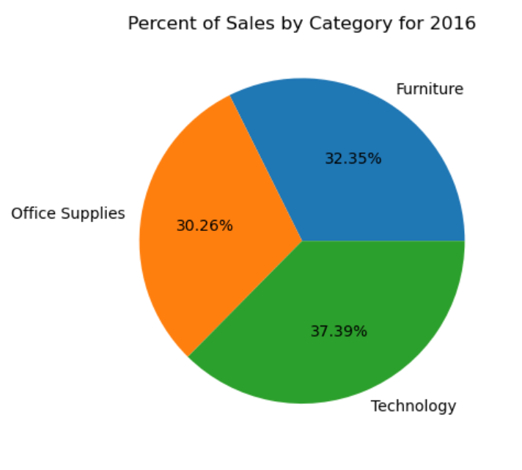
2016

Slide 50
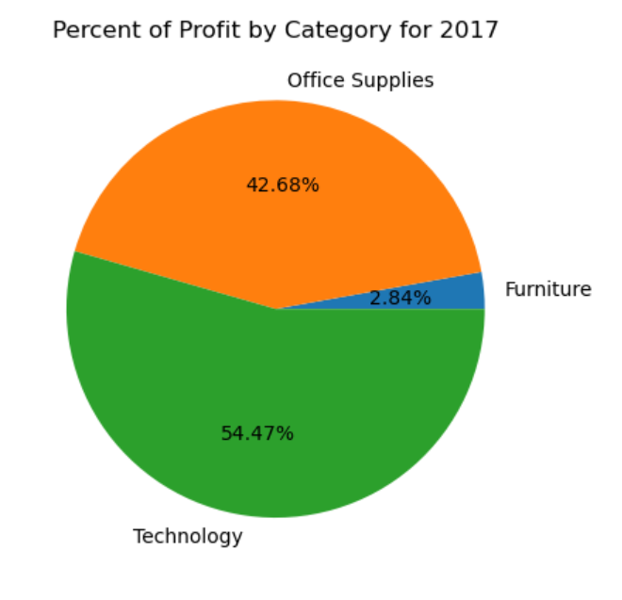
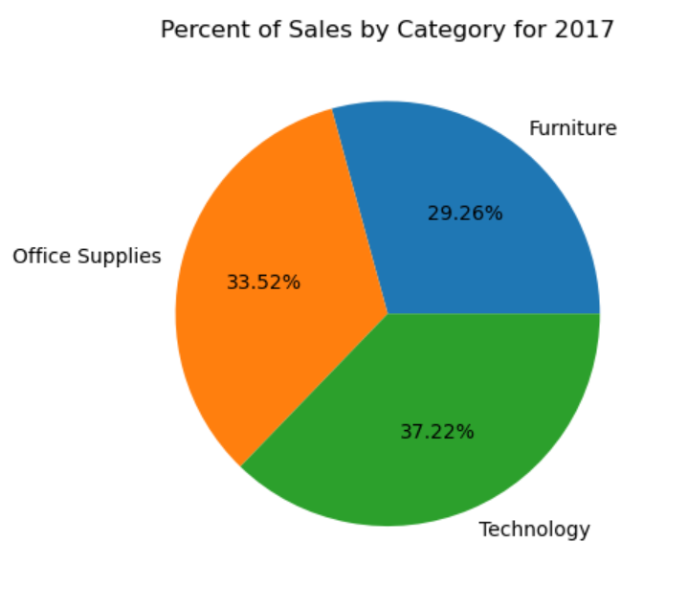
2017

Slide 51
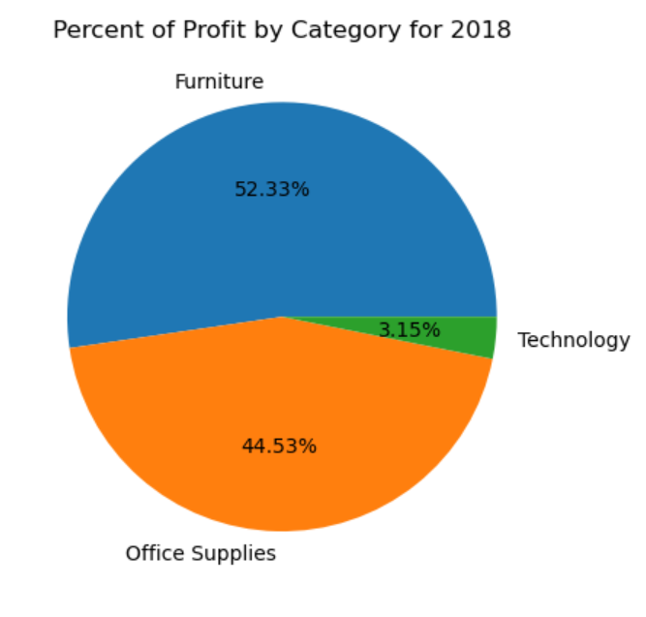
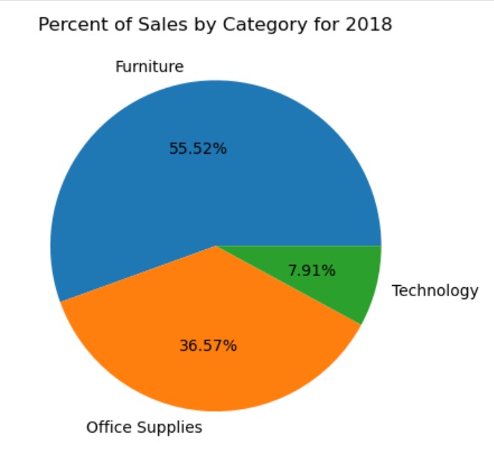
2018

Slide 52
SQL
finding the most profitable days

Slide 53
interactive HTML
Sales and profit map
Yearly growth by state

Slide 54
Conclusion

Slide 55




The winner
2014
MR. SM ($ 23,661.228; Jacksonville, Florida)
2015
Mr. PF ($ 9,022.324; New York City, New york)
2016
ms. TC ($ 18,344.052; Lafayette, indiana)
2017
mr. RB ($ 14,203.278; Seattle, Washington)

Slide 56




highest sales state
highest profit state

Slide 57
THANK YOU

